Slide 1
Adaptive Reconstruction Methods for Low-Dose Computed Tomography
Joseph Shtok
Ph.D. supervisors: Prof. Michael Elad, Dr. Michael Zibulevsky.
Technion IIT, Computer Science dept.
Israel, 2011

Slide 2
Contents of this talk
Intro to Computed Tomography
Adaptive FBP
Framework of adaptive reconstruction
General scheme of supervised learning
Learned FBP filter for local reconstruction
Sparsity-based sinogram restoration
Learned shrinkage in a transform domain
Performance boosting of existing algorithms
Local fusion of multiple versions of the algorithm output
Adaptation of the method to low-dose CT reconstruction
Adaptation of K-SVD to low-dose CT reconstruction
Scan model, Noise, Local reconstruction
Then you get tired of me.

Slide 3
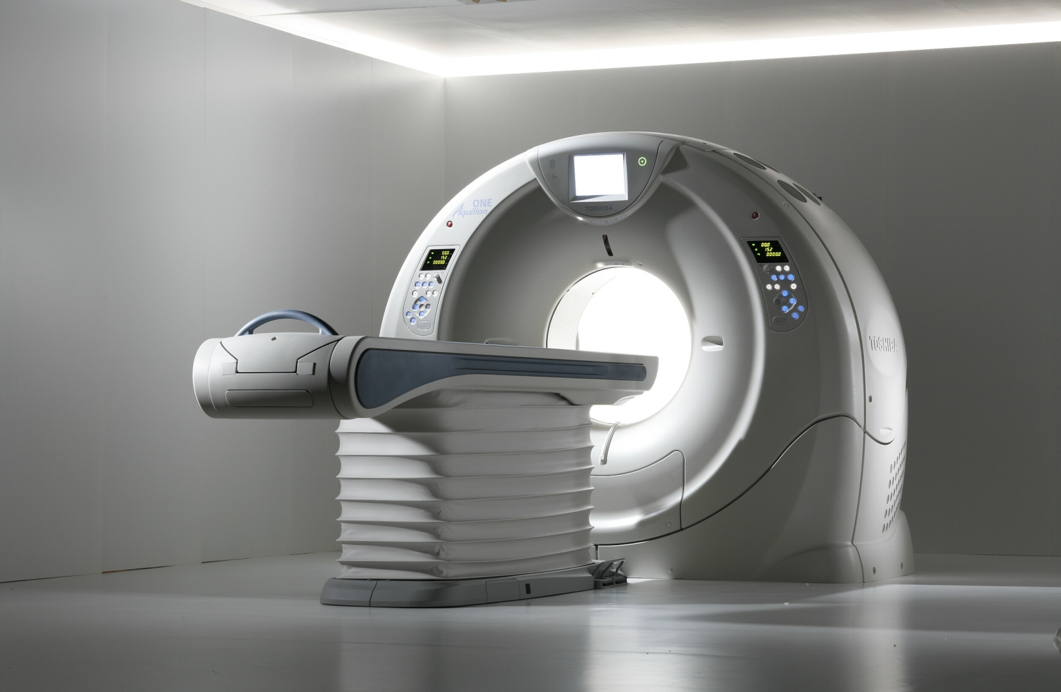
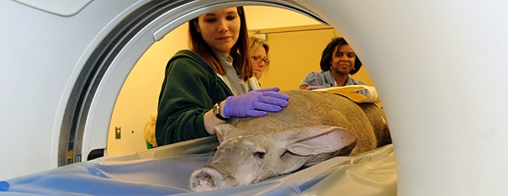
Short Intro to Computed Tomography
Assume you have a shiny new CT scanner…
And an aardvark has scheduled a head scan for today.

Slide 4
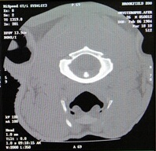
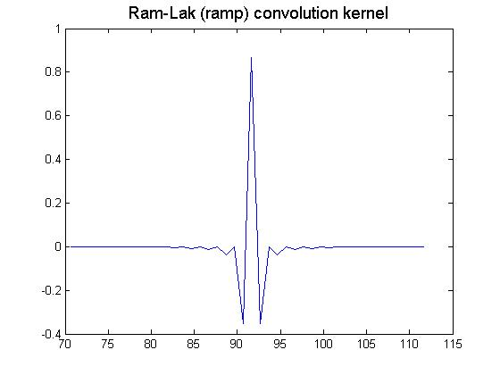
Short Intro to Computed Tomography
Filtered Back-Projection (FBP)
X-ray source
photons
Sum contributions to from all incident rays
Back-Projection
Detectors
Line
Ram-Lak filter
photon counts
Sinogram values
Radon (X-ray) transform

Slide 5
Noise in Low-Dose Reconstruction
Accepted model for detector measurements (similar to one in CCD sensors):
instance
- ideal count
Poor photon statistics due to low counts
Electronic noise in the hardware
instance
Large attenuation
High integral value
Low count
High noise variance
Streak artifacts
instance

Slide 6
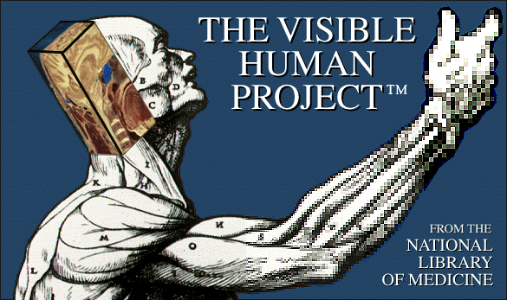
Noise in Low-Dose Reconstruction
Projection and log-transform
+
Ideal sinogram
Stochastic data-dependent noise
FBP
Ideal inverse Radon
FBP
Smoothed inverse Radon
FBP+prep
Adaptive Median Filtering (Hsieh, 98)
MAP estimate
Iterative statistically-based PWLS

Slide 7
Problem of local reconstruction
A point in the image draws a sine.
Points outside the ROI contribute to its projections.
ROI is not uniquely determined from the truncated data.

Slide 8
Problem of local reconstruction
FBP reconstruction from zero-padded truncated projections
Basic sinogram completion: duplicate the margins.
Non-linear sine-based sinogram completion

Slide 9
Intro to Computed Tomography
Adaptive FBP
Framework of adaptive reconstruction
General scheme of supervised learning
Learned FBP filter for local reconstruction
Sparsity-based sinogram restoration
Learned shrinkage in a transform domain
Performance boosting of existing algorithms
Local fusion of multiple versions of the algorithm output
Adaptation of the method to low-dose CT reconstruction
Adaptation of K-SVD to low-dose CT reconstruction
Scan model, Noise, Local reconstruction

Slide 10
Error measure for CT reconstruction
reference image
reconstructed image
Basic error measure: Mean Square Error (MSE)
Problem: MSE can be reduced by blurring the image.
Sharpness-promoting penalty: the gradient norm in should not fall below the gradient norm in .
Nuances:
The MSE component is restricted to regions of interest
The gradient-based component is restricted to fine edges.
The non-negativity function is smoothed for better optimization.

Slide 11

Supervised learning of adaptive processing tools
Minimize the error measure w.r.t. parameters
High-quality reference CT images .
Degraded photon counts
Error measure
Learnable parameters p,q,r
Pre-processing
FBP recon
Post-processing
Reconstruction chain
Output image - a function of

Slide 12
Intro to Computed Tomography
Adaptive FBP
Framework of adaptive reconstruction
General scheme of supervised learning
Learned FBP filter for local reconstruction
Sparsity-based sinogram restoration
Learned shrinkage in a transform domain
Performance boosting of existing algorithms
Local fusion of multiple versions of the algorithm output
Adaptation of the method to low-dose CT reconstruction
Adaptation of K-SVD to low-dose CT reconstruction
Scan model, Noise, Local reconstruction

Slide 13
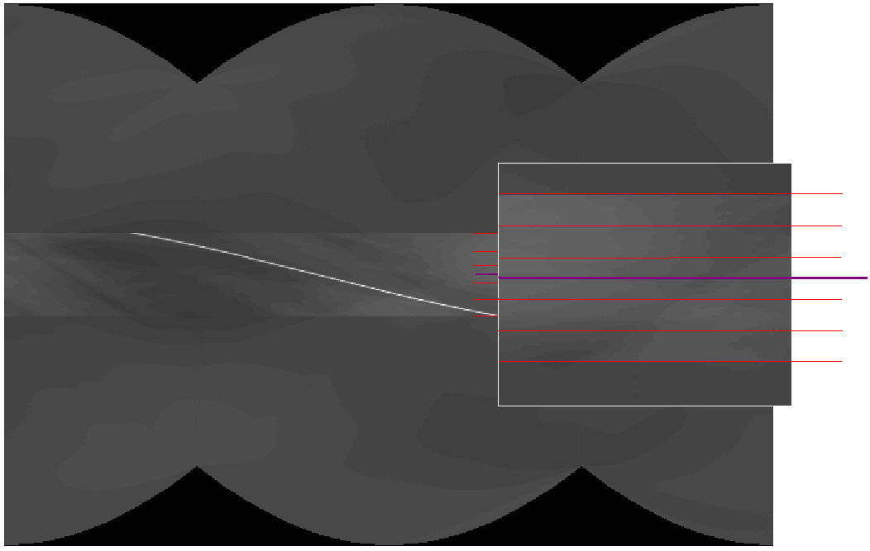
Learned FBP filter for ROI reconstruction
FBP operator:
Train the convolution kernel to pursuit reconstruction goals.
Training objective for ROI reconstruction:
-Truncated sinogram
after completion.
Training objective:
- Binary mask,
restriction to ROI.
Truncated sinogram with completion
1. Use 2-D kernel.
Reference FBP reconstruction
Reference AFBP reconstruction
. . .
2. Filter the sinogram with radially-variant convolution kernel.

Slide 14
ROI reconstruction
Image size = 461 pixels.
ROI radius = 34 pixels,
Margin = 3 pixels.
True ROI image | FBP reconstruction 22.9 dB | AFBP reconstruction 34.68 dB

Slide 15
ROI reconstruction
Image size = 461 pixels.
ROI radius = 34 pixels,
Margin = 3 pixels.
True ROI image | FBP reconstruction 18.04 dB | AFBP reconstruction 29.63 dB

Slide 16
ROI reconstruction
Image size = 461 pixels.
ROI radius = 34 pixels,
Margin = 3 pixels.
True ROI image | FBP reconstruction 19.48 dB | AFBP reconstruction 31.44 dB

Slide 17
Intro to Computed Tomography
Adaptive FBP
Framework of adaptive reconstruction
General scheme of supervised learning
Learned FBP filter for local reconstruction
Sparsity-based sinogram restoration
Learned shrinkage in a transform domain
Performance boosting of existing algorithms
Local fusion of multiple versions of the algorithm output
Adaptation of the method to low-dose CT reconstruction
Adaptation of K-SVD to low-dose CT reconstruction
Scan model, Noise, Local reconstruction

Slide 18
Sparse-Land model for signals
The concept: natural signals admit a faithful representation using only few columns (atoms) from a dedicated overcomplete dictionary.
Natural dictionaries: Wavelets, Haar functions, Discrete Cosines, Fourier.
Number of non-zeros is small
Residual is small
Dictionaries tailored to the specific family of signals: obtained via a training process.

Slide 19
Sparse-Land model for signals
Denoising technique (Elad, Aharon, 2006):
- Noisy image
Minimize w.r.t
Minimize w.r.t
(K-SVD) Train a dictionary D along with sparse representations
2. Compute the image estimate (closed-form solution).
Sparse coding:
State-of-the-art noise reduction.
Adaptive to current image or training set.
Uniform noise assumption.
Variable is the i-th column in .
Dictionary update:

Slide 20
Application to CT reconstruction
Previous work (Liao, Sapiro, 2007):
Patch-wise sparse coding of CT image .
Online learning from noisy data.
Very nice results on geometric images under severe angular subsampling.
Drawbacks:
Data fidelity term in the sinogram domain.
No reference to statistical model of the noise.
Sparse coding thresholds not treated.

Slide 21
Application to CT reconstruction
Our approach:
1. check data fidelity and perform sparse coding in the domain of noise-normalized raw data :
Solve for using K-SVD, but allow to use a different dictionary at restoration stage:

Slide 22
Application to CT reconstruction
2. Train a second dictionary optimized for image reconstruction using a designed error measure and pre-computed repersentations :
Reconstruction chain:
Sparse coding with
Photon counts
Represen-tations
Data
Small patches
CT image
Sinogram
Improved data
FBP reconstruction
Data restoration with

Slide 23
Compared algorithms
Adaptive Trimmed Mean (ATM) Filter Hsieh, ’98.
Extract M values from the neighborhood of a photon count .
Remove extreme values and compute the average of the rest.
are data-dependent; computed through
In our experience: depends highly on the parameters.
Penalized Weighted Least Squares (PWLS) Elbakri, Fessler, ’02.
2-nd order aproximation of a penalized log-likelihood expression for photon counts data:
Penalty weight. Controls variance-resolution tradeoff.
Huber penalty (smoothed norm).
Works quite well.

Slide 24
Empirical results
Thighs section
FBP, 25.76 dB | ATM, 28.32 dB | PWLS, 28.90 dB | Sparse, 29.62 dB
Recon. in
[-220,350] HU
Error images

Slide 25
Empirical results
Thighs section
FBP, 25.26 dB | ATM, 27.46 dB | PWLS, 28.26 dB | Sparse, 27.94 dB
Recon. in
[-220,350] HU
Error images

Slide 26
Empirical results
Same parameters, new anatomical region.
Head section
FBP, 29.84 dB | ATM, 29.83 dB | PWLS, 31.02 dB | Sparse, 32.36 dB
Recon. in
[-170,250] HU
Error images

Slide 27
Intro to Computed Tomography
Adaptive FBP
Framework of adaptive reconstruction
General scheme of supervised learning
Learned FBP filter for local reconstruction
Sparsity-based sinogram restoration
Learned shrinkage in a transform domain
Performance boosting of existing algorithms
Local fusion of multiple versions of the algorithm output
Adaptation of the method to low-dose CT reconstruction
Adaptation of K-SVD to low-dose CT reconstruction
Scan model, Noise, Local reconstruction

Slide 28
Learned shrinkage in a transform domain
Analysis
Synhtesis
Recon-struction
Convert to z-domain
Shrinkage
Scalar shrinkage functions
Dictionary
(pseudo-inverse)
Denoising by supression of small coefficients, which usually
contain the noise.
Examples of : Discrete Cosines, Wavelets, etc.
LUT
Denosing by shrinkage of wavelet coeffs: Donoho & Johnston, 1994.
The tool: Descriptive functions for descriptive dictionary.
Denoising with learned shrinkage functions: Hel-Or and Shaked, 2002.
The tool: Learned functions for descriptive dictionary.
Our goal: Solving non-linear inverse problems.
The tool: Learned functions for learned dictionary in a look-ahead training.

Slide 29
Learned shrinkage in a transform domain
Preparing the data
Photon counts
Data
Small patches
convert to sinogram
train
train
Compare to referenve image
Compare to clean training data
FBP
reconstruction
Synthesis
Analysis
LUT
Objective 1: best data quality
Objective 2: best image quality
Pre-processing

Slide 30
Why not repeat the trick?
Image
shrinkage
FBP recon
Raw data shrinkage
Post-processing with shrinkage functions, also trained by comparing to reference images.
Difference made by the post-processing : no image structure lost.

Slide 31
Empirical results
Thighs section (male)
FBP, 25.76 dB | ATM, 28.32 dB | PWLS, 28.90 dB | Shrinkage 30.05 dB
Recon. in
[-220,350] HU
Error images

Slide 32
Empirical results
Different PWLS parameters
Thighs section (male)
FBP, 26.56 dB | ATM, 28,70 dB | PWLS, 31.04 dB | Shrinkage 30.73 dB
Recon. in
[-220,350] HU
Error images

Slide 33
Empirical results
Thighs section
FBP, 25.26 dB | ATM, 27.46 dB | PWLS, 28.26 dB | Shrinkage 28.94 dB
Recon. in
[-220,350] HU
Error images

Slide 34
Empirical results
Head section
FBP, 29.84 dB | ATM, 29.83 dB | PWLS, 31.02 dB | Shrinkage 32.81dB
Recon. in
[-170,250] HU
Error images

Slide 35
Alternative versions
Optimizing for MSE introduces a blur into the image.
Thighs section
FBP, 27.70 dB 25.76 dB | PWLS, 30.45 dB 28.90 dB | Shrinkage 30.84 dB 30.05 dB
MSE-optimized versions
Tuned by visual appearance

Slide 36
Effective dose reduction
Estimating dose reduction factor:
For each noise level, sweep over a range of FBP parameter and chose a reconstruction with minimal error measure.
Sweep over a range of the noise level and compare to learned shrinkage.
Normal X-ray dose range
Low X-ray dose range

Slide 37
Contents of this talk
Intro to Computed Tomography
Adaptive FBP
Framework of adaptive reconstruction
General scheme of supervised learning
Learned FBP filter for local reconstruction
Sparsity-based sinogram restoration
Learned shrinkage in a transform domain
Performance boosting of existing algorithms
Local fusion of multiple versions of the algorithm output
Adaptation of the method to low-dose CT reconstruction
Adaptation of K-SVD to low-dose CT reconstruction
Scan model, Noise, Local reconstruction

Slide 38
Fusion over a smoothing parameter
Scalar parameter
Recon.
algorithm
Raw data
Image
…
The algorithm:
Sweep the variance-resolution tradeoff.
Extract pixel neighborhood (or other
features) from each version.
Build a decision rule to perform the local
fusion.
…
Decision rule
Artificial Neural Network (ANN)
Decision rule:
Use a regression to build one automatically,
with a Neural network or Support Vector
Regression.

Slide 39
Fusion over a smoothing parameter
FBP algorithm: sweep the cut-off frequency of the low-pass sinogram filter.
Collect few images with different resolution-variance trade-off.
PWLS algorithm: perform the regular reconstruction while collecting versions along the iterations.
Initial image
Converged image
Created with FBP
Standard PWLS result
versions from partial iterations

Slide 40
Empirical results
Thighs section
FBP 25.76 dB | FBP-ANN 30.62 dB | PWLS 28.90 dB | PWLS-ANN 31.11 dB
Recon. in
[-220,350] HU
Error images

Slide 41
Empirical results
Thighs section
FBP 25.26 dB | FBP-ANN 29.67 dB | PWLS 28.26 dB | PWLS-ANN 30.03 dB
Recon. in
[-220,350] HU
Error images

Slide 42
Empirical results
Head section
FBP 29.84 dB | FBP-ANN 33.41dB | PWLS 31.02 dB | PWLS-ANN 33.66 dB
Recon. in
[-170,250] HU
Error images

Slide 43
Intro to Computed Tomography
Adaptive FBP
Framework of adaptive reconstruction
General scheme of supervised learning
Learned FBP filter for local reconstruction
Sparsity-based sinogram restoration
Learned shrinkage in a transform domain
Performance boosting of existing algorithms
Local fusion of multiple versions of the algorithm output
Adaptation of the method to low-dose CT reconstruction
Adaptation of K-SVD to low-dose CT reconstruction
Scan model, Noise, Local reconstruction
Conclusions

Slide 44
Parade of proposed methods
Thighs section
Sparse 29.62 dB | Shrinkage 30.05 dB | FBP-ANN 30.62 dB | PWLS-ANN 31.11 dB
Recon. in
[-220,350] HU
Error images

Slide 45
Summary
Adaptive methods can help improving CT reconstruction.
FBP needs only a little help to allow truly local reconstruction.
Once the raw data is variance-normalized, the sparsity-based denoising mends most of the damage done by the low-dose scan.
When the smootheness parameter is swept, reconstruction algorithms supply more information about the image; it is easily extracted by a regression function using only the intensity values.
Example-based training does not jeopardize the image content (in the presented algorithms) and can be allowed for clinical use.

Slide 46
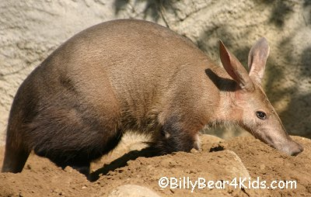
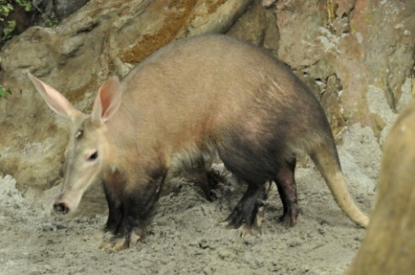
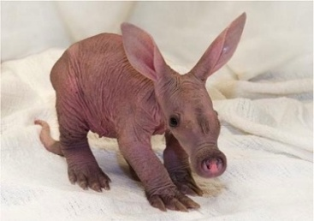
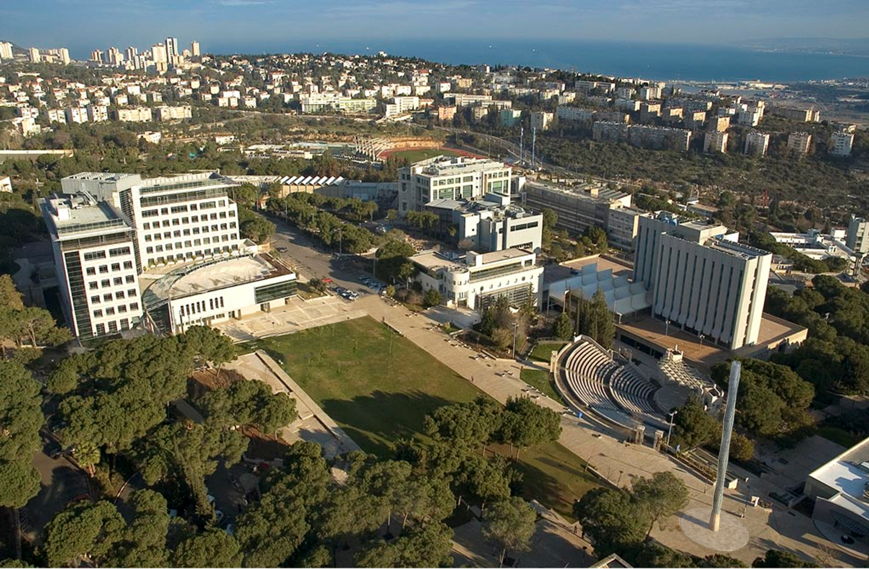
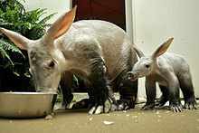
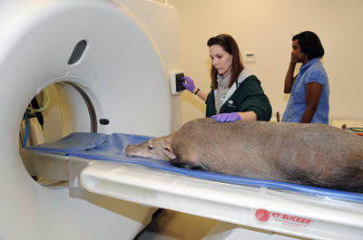
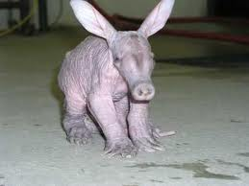
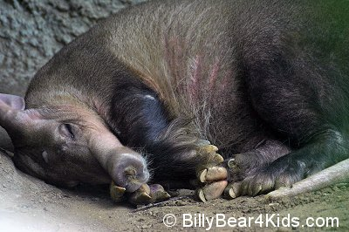
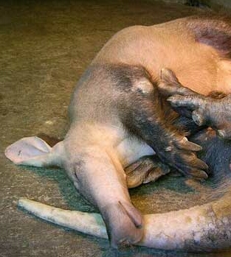
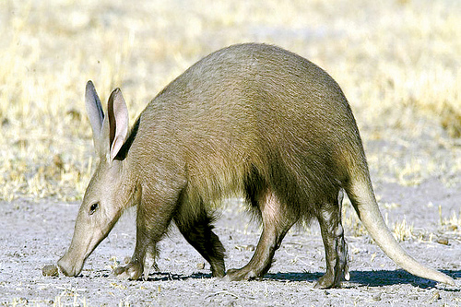
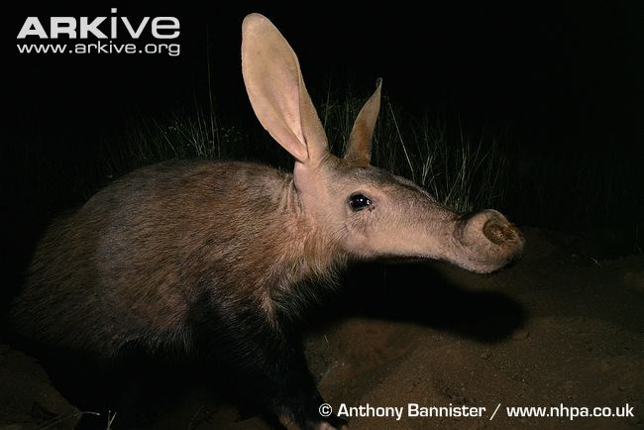
Thank you.

Slide 47
SNR values in [-220,350] HU window (for thighs) and [-170, 250] HU (for head)
FBP-PWLS | FBP-ANN | Shrinkage | Sparse | PWLS | ATM | FBP |  | Methods
31.83 | 31.07 | 30.7312 | 30.0595 | 29.5637 | 28.7075 | 26.5607 | Full obr | Thighs test Image
31.11 | 30.62 | 30.0554 | 29.6291 | 28.9008 | 28.3262 | 25.7668 | Square 1
30.03 | 29.67 | 28.9308 | 27.9429 | 28.2660 | 27.4631 | 25.2677 | Square 2
33.8978 | 33.7565 | 33.31 | 32.78 | 31.6005 | 29.95 | 29.9508 | Full obr | Head test image
33.66 | 33.4179 | 32.84 | 32.36 | 31.0254 | 29.83 | 29.8407 | Square 1
 |  | 30.84 |  | 30.45 |  | 27.70 | Square 1 | Thighs test Image – MSE enhanced

